Slide 1

NLP techniques used in ChatGPT
This Photo by Unknown Author is licensed under CC BY-SA-NC

Slide 2


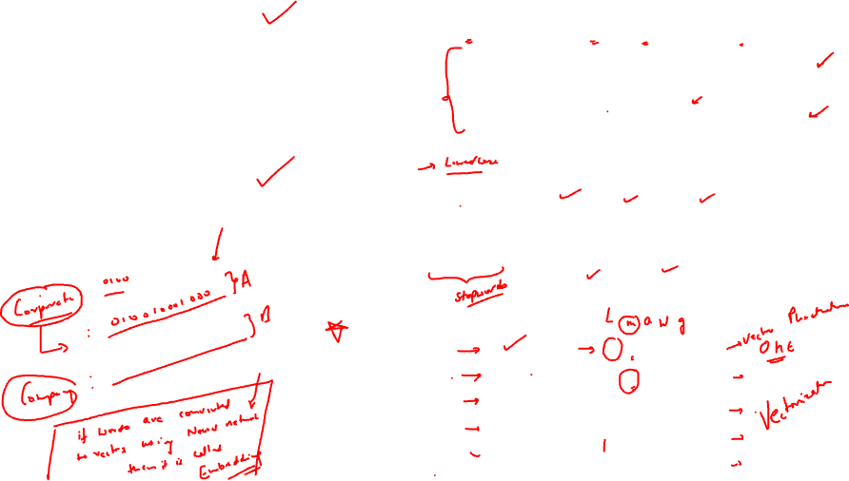
Text given to ChatGPT:
Let me explain it to you !!
1. Tokenization
How can ChatGPT understand “TEXT”??
I loved the movie Avtaar. It was great. Wow!!
Split text to words called “TOKENS”
i
loved
the
movie
avtaar
.
it
was
great
.
wow
!!
2. Text Cleaning
Remove Punctuation & Insignificant words
was
I
loved
movie
avtaar
it
the
great
wow
.
!!
.
loved
1 0 0 0 0
3. Vectorization
movie
0 1 0 0 0
Convert Tokens to NUMBERS
avtaar
0 0 1 0 0
wow
0 0 0 1 0
great
0 0 0 0 1

Slide 3
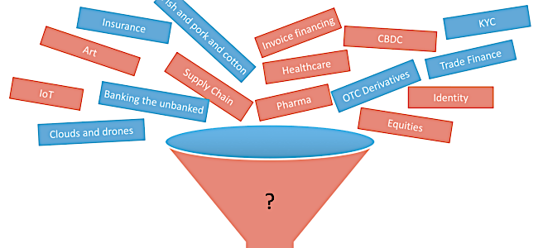

Document
Punctuations
Text Data Cleaning
Lower case
Stopwords
Paragraph
Tokenization
Sentences
Words ~tokens
POS
NER
Token Processing
Stemming / Lemmatization
OHE
Vectorization
Tf-idf
word2Vec

Slide 4


POS tagging
POS tagging, short for Part-of-Speech tagging, is an NLP technique that assigns grammatical categories (part-of-speech tags) to words in a given text.
It helps determine the syntactic category or grammatical function of each word, such as noun, verb, adjective, adverb, etc.
For instance, in the sentence
"I like to go for a walk in the park”
POS tagging would label
"I" as a pronoun (PRP),
"like" as a verb (VB), and so on.

Slide 5


NER tagging
NER tagging, which stands for Named Entity Recognition tagging, is an important task in natural language processing (NLP).
It involves identifying and classifying named entities in text into predefined categories such as person names, organizations, locations, dates, percentages, and more.
For example, consider the sentence:
"Apple Inc. is planning to open a new store in New York City next month."
NER tagging would identify and label the named entities as follows:
"Apple Inc." as an organization
"New York City" as a location
"next month" as a date or time

Slide 6

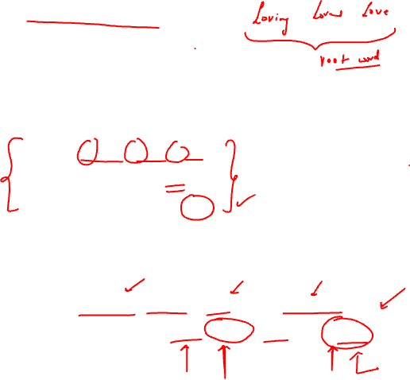
Stemming
Process of reducing words to their base words or root words.
Input: “going, goes, gone”
Stemming output: “go”
The root word here is ‘go’
Disadvantage: it may end up removing the meaning of the word. Like:
Input: "Dancing dancers dance and danced.”
Stemmed Output: "Danc dancer danc and danc.”

Slide 7
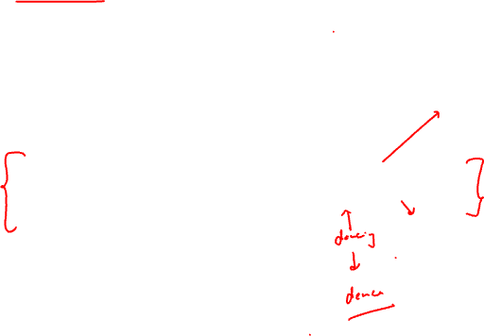
Lemmatization
To resolve the disadvantage od stemming there is a process used called : Lemmatization. Lemmatization tends to give meaningful words.
At the backend it has the entire dictionary of words to use it. Hence it takes time to give the meaningful root words.
Advantage: Gives meaningful words
Disadvantage: It takes time

Slide 8
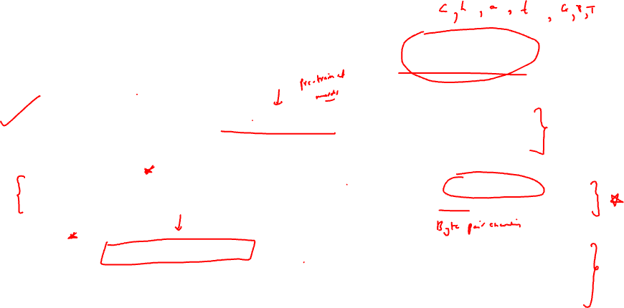
NLP Techniques used in ChatGPT
Tokenization: Libraries like Hugging Face's Tokenizers, NLTK, or SpaCy provide functionality for tokenization.
Subword Tokenization: Libraries like Hugging Face's Tokenizers, SentencePiece, or Subword-NMT implement subword tokenization algorithms like BPE or SentencePiece.
Encoding: TensorFlow or PyTorch frameworks are commonly used for encoding tokens into numerical representations. The specific implementation may depend on the architecture and model version.
NMT ~ Neural Machine Translation

Slide 9
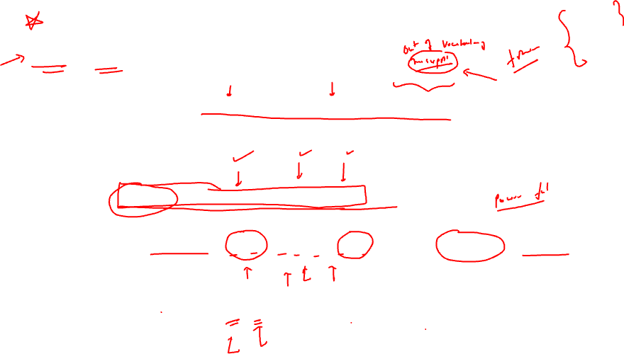
Byte Pair Encoding
BPE is an algorithm that merges the most frequent pairs of characters in a text iteratively, creating a vocabulary of subword units.
BPE Encoding Example:
Input Text: "ChatGPT is a powerful language model." BPE Encoding:
Step 1: Split into characters: ['C', 'h', 'a', 't', 'G', 'P', 'T', ' is', ' a', ' powerful', ' language', ' model', '.’]
Step 2: Apply BPE merging: ['Ch', 'at', 'G', 'P', 'T', ' is', ' a', ' powerful', ' language', ' model', '.']

Slide 10
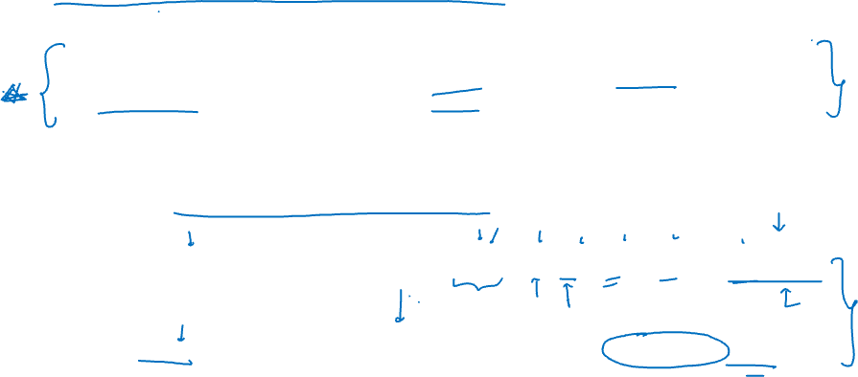
Sentence Piece Tokenization
SentencePiece is a more recent approach that provides a unified framework for various subword tokenization algorithms, including BPE. It offers additional features like support for custom tokenization rules, and compatibility with different modelling frameworks.
SentencePiece Encoding Example:
Input Text: "ChatGPT is a powerful language model." SentencePiece Encoding:
Step 1: Vocabulary generation: Vocabulary: ['▁Chat', 'G', 'PT', '▁is', '▁a', '▁power', 'ful', '▁language', '▁model', '.’]
Step 2: Encoding the input text using the SentencePiece model: Encoded Text: ['▁Chat', 'G', 'PT', '▁is', '▁a', '▁power', 'ful', '▁language', '▁model', '.']

Slide 11
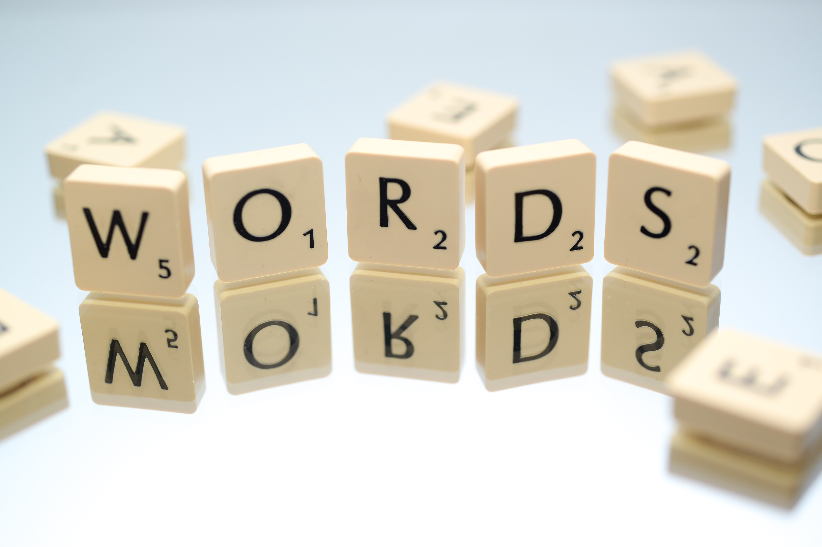
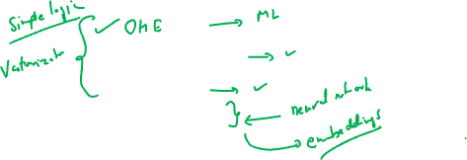
Vectorization/ Word embeddings
A technique by which words are converted to numbers. Each word is mapped to a vector.
The vectors try to capture various characteristics of that word with regard to the overall text.
Bag of words
Tf-idf
Word2Vec

Slide 12

Bag of Words
Bag of Words (BoW) is a document representation technique where text (like a sentence or a document) is represented as the bag (multiset) of its words, disregarding grammar and even word order but keeping multiplicity.
In simple terms, it creates a vocabulary of all the unique words in the text and represents each sentence or document as a vector with counts of how many times each word appears in the text.
The vector length is equal to the length of the created vocabulary. One major disadvantage of BoW is that it treats words individually and disregards the context or order in which they appear, which can lead to loss of meaning.

Slide 13
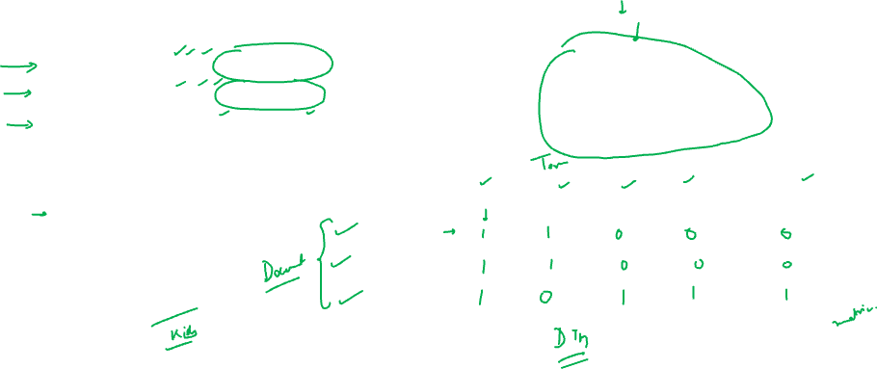
Bag of Words
Stopwords: He , is , a, is , a , and, are
Document 1 | He is a data scientist
Document 2 | She is a data scientist
Document 3 | Men and women are data professional
Document 1 | data scientist
Document 2 | data scientist
Document 3 | Men women data professional
Vocabulary(unique words):
Data
Scientist
Men
Women
Professional
Vocabulary | data | scientist | men | women | professional
Document 1
Document 2
Document 3

Slide 14
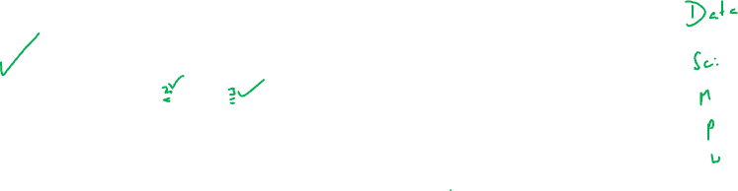
Vocabulary | data | scientist | men | women | professional
Document 1 | 1 | 1 | 0 | 0 | 0
Document 2 | 1 | 1 | 0 | 0 | 0
Document 3 | 1 | 0 | 1 | 1 | 1
Order of words in bag of words is based on frequency, if a word is repeated more than once in a document, we mention that frequency for that feature across that document. Each word acts as a “feature”

Slide 15
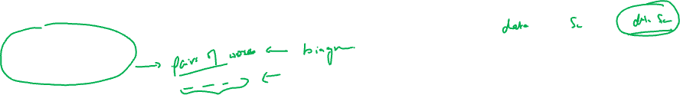
Ngrams
N-grams are contiguous sequences of n items from a given sample of text or speech.
They are widely used in natural language processing and computational linguistics.
When working with text, an item could be a character, a word, or a sentence, and 'n' can be any integer.
When 'n' is 1, this is referred to as a "unigram".
Similarly, a 2-gram (or bigram) is a two-word sequence of words like "please turn", "turn your", and "your homework".
A 3-gram (or trigram) is a three-word sequence of words like "please turn your", and "turn your homework".

Slide 16
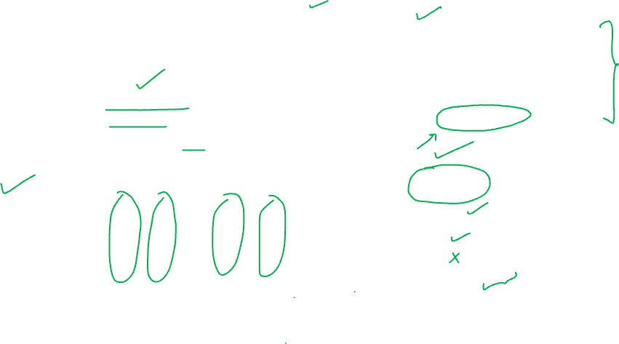
N grams(example with biagram)
Vocabulary(unique words):
Data
Scientist
Men
Women
Professional
“data scientist” ….biagram
Document 1 | data scientist
Document 2 | data scientist
Document 3 | Men women data professional
Vocabulary | data | scientist | men | women | professional | Data scientist
Document 1 | 1 | 1 | 0 | 0 | 0 | 1
Document 2 | 1 | 1 | 0 | 0 | 0 | 1
Document 3 | 1 | 0 | 1 | 1 | 1 | 0
You can have 3 words together too, that is called “trigram” and so on , there is possibility to create n-grams too.

Slide 17
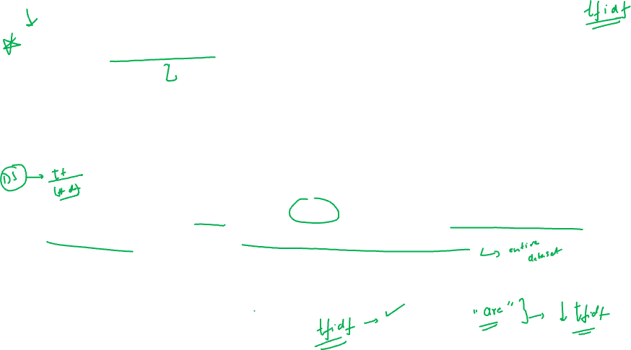
Term Frequency Inverse Document Frequency
TF-IDF (Term Frequency-Inverse Document Frequency) is a numerical statistic used in information retrieval and text mining to quantify the importance of a term in a document within a collection or corpus of documents.
It evaluates the relevance of a term by considering its frequency in a specific document and its rarity across the entire corpus.
Concept: give lower weights to common words and higher weights to rare words

Slide 18
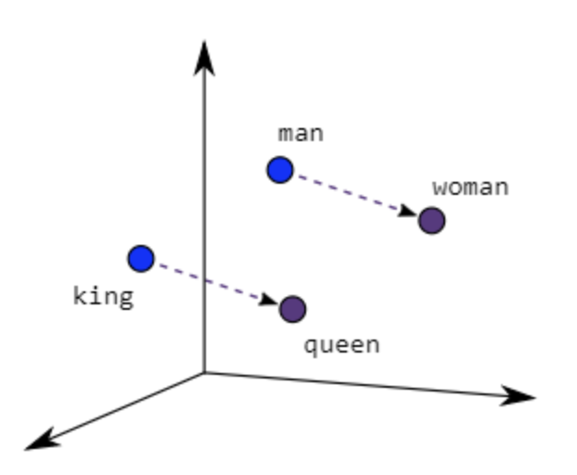
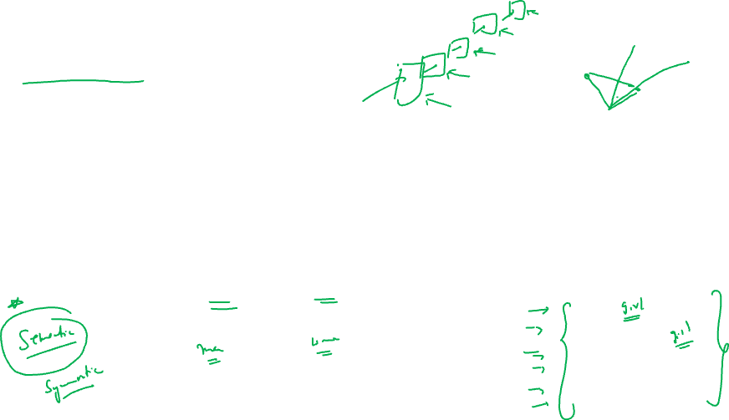
Word2Vec
Each word is represented as a vector of 32 or more dimensions.
The semantic information and the relation between different words is preserved.
More similar words are plotted closer to each other.
Given a large enough dataset, Word2Vec can make strong estimates about a word’s meaning based on their occurrences in the text.
For example, words like “King” and “Queen” would be very similar to one another.

Slide 19
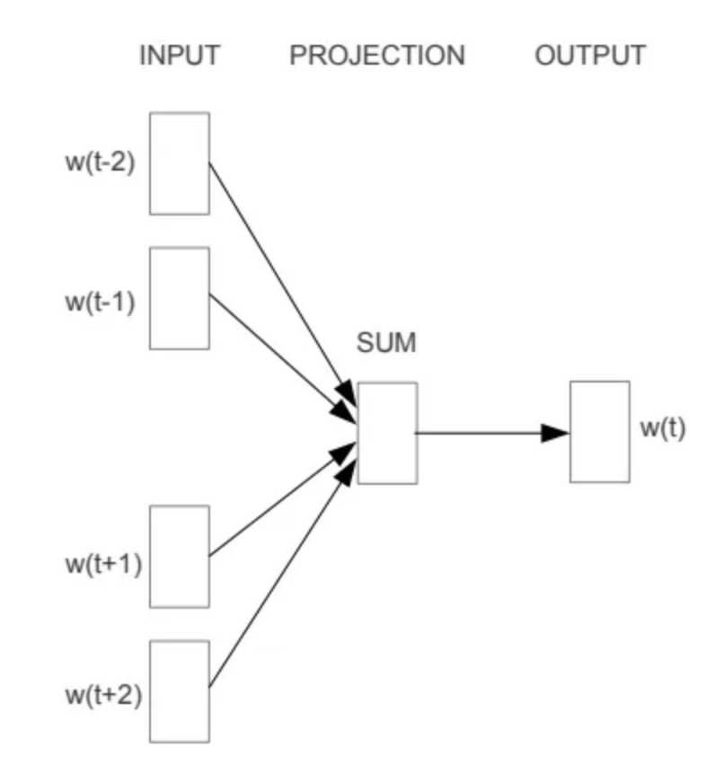
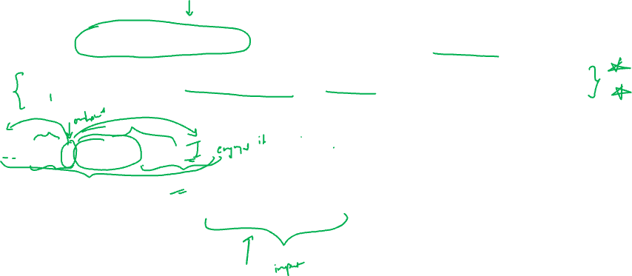
There are two main architectures which yield the success of word2vec:
CBOW: Continuous bag of Words is specifically designed to predict a target word based on its surrounding context words.
It operates by training a neural network to minimize the loss between the predicted target word and the actual target word.
“It is a beautiful day”
If “target word” is “a”
Then context words are “it is beautiful day”

Slide 20
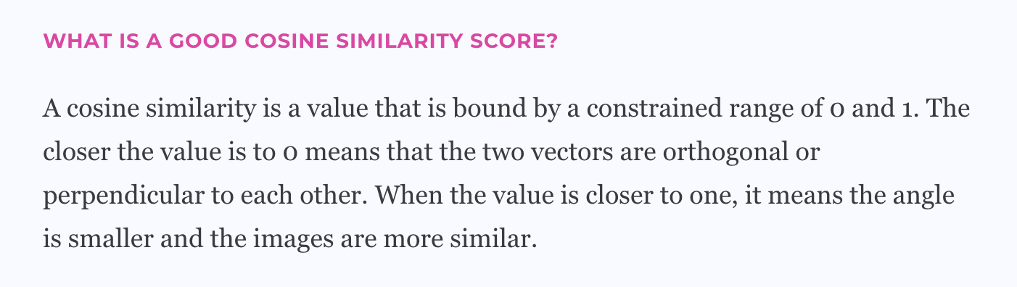
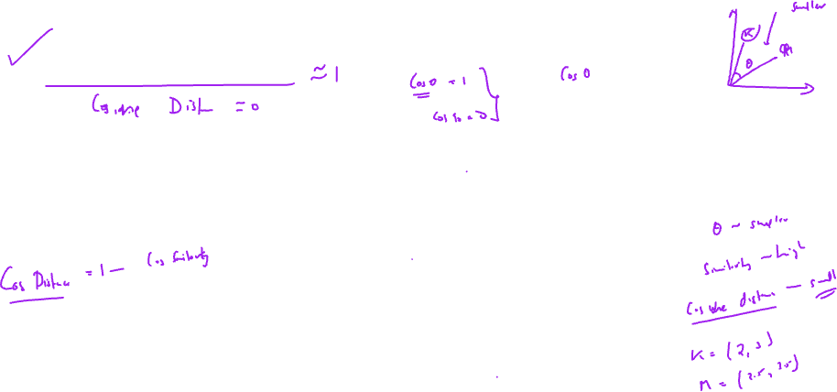
Cosine Similarity
Cosine similarity is a measurement that quantifies the similarity between two or more vectors. It’s the cosine of the angle between vectors, which are typically non-zero and within an inner product space.

Slide 21
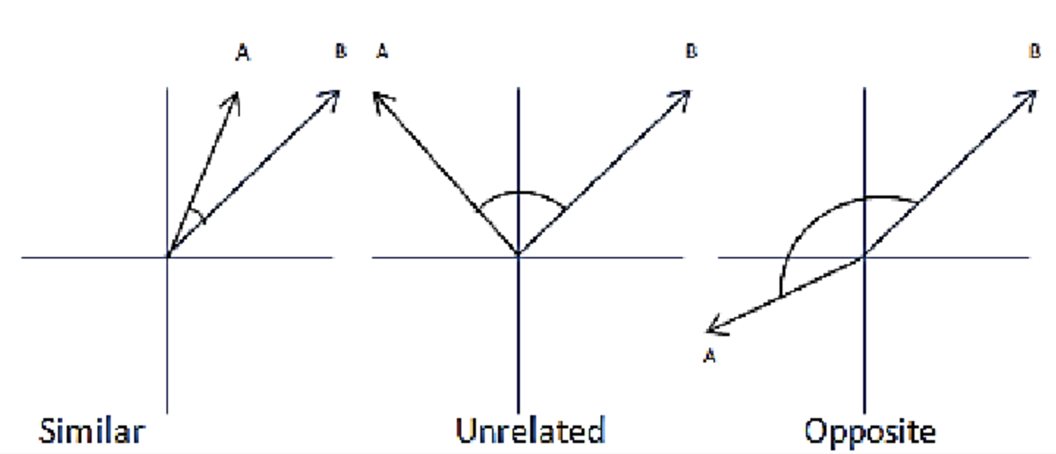

If angle between two words (vectors) is small , cosine similarity will be closer to 1 and cosine distance will be closer to 0

